Slide 1
PharmacAI Case: Digital Pharmacy
Team Ricola
30.11.2023
Digitalization of Business Processes in Healthcare
Adrian Altermatt, Jana Brzak, Shathvika Karunakaran & Sarah Meyer

Slide 2

TABLE OF CONTENTS
PharmacAI
Introduction
Use Case – Problem ​
As-Is vs. To-Be process ​
Implementation​
Benefits​
Scenario​
Demo

Slide 3
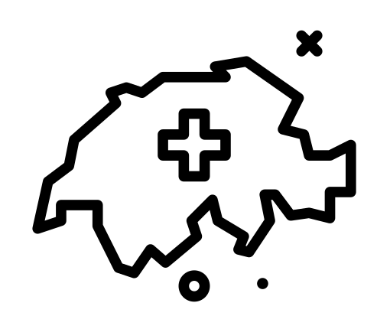



Introduction
PharmacAI

Slide 4

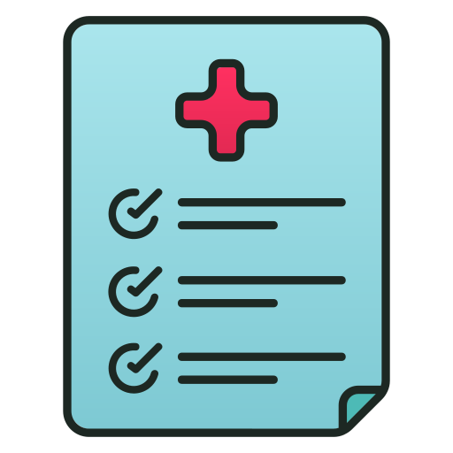



Use Case
PharmacAI
Patient goes to the doctor for his symptoms
Patient gets a prescription from doctor
Patient goes to pharmacy to get the drugs
Patient has to wait for a long time
Finally the patient gets his drugs
The patient can go home

Slide 5
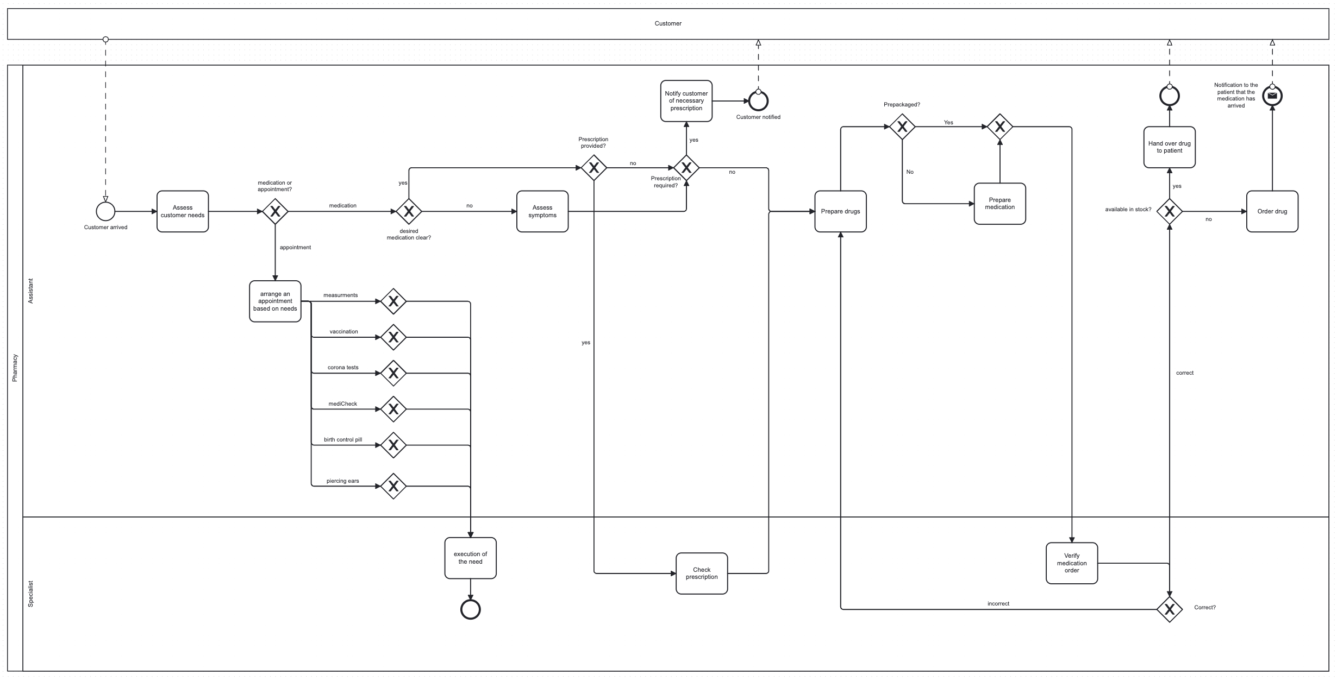
As-Is Process
PharmacAI

Slide 6
Issues with the current As-Is process
PharmacAI
Waiting times
Limited opening hours
Personal presence required
Confidentiality and stigma
Cost
Language barrier

Slide 7
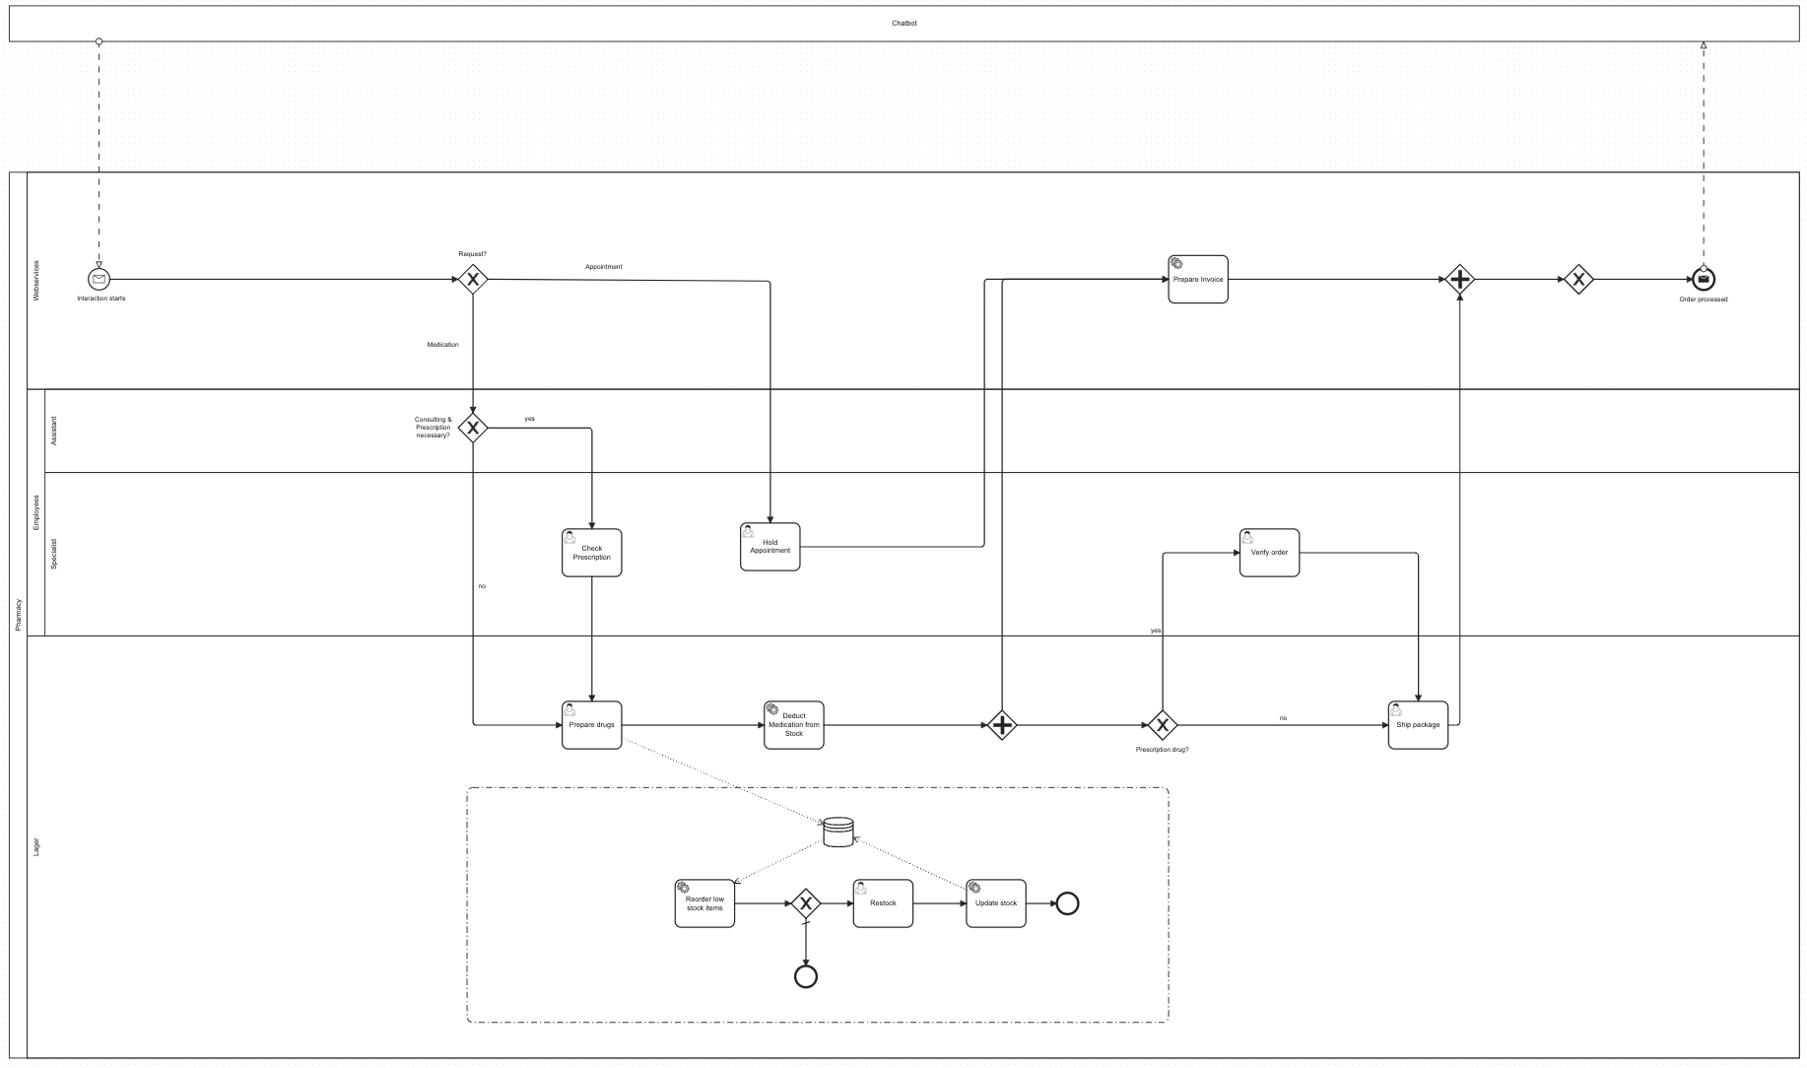
To-Be Process
PharmacAI

Slide 8
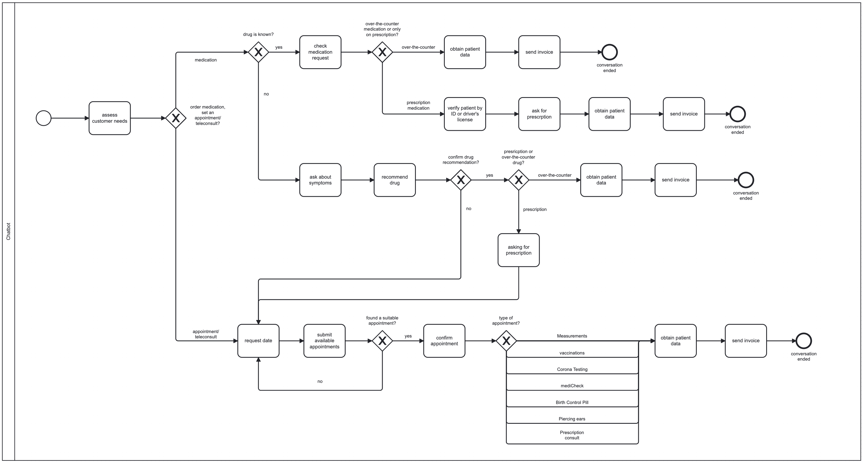
Chatbot

Slide 9





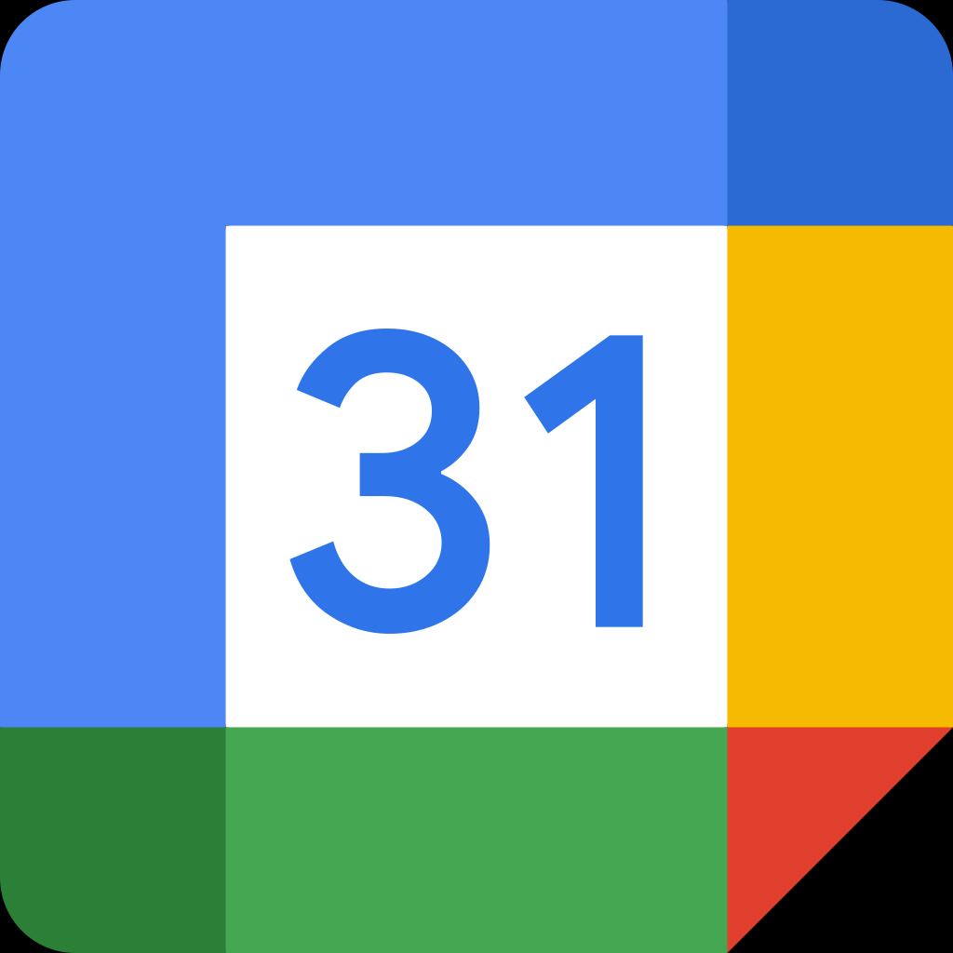

Implementation
PharmacAI
Camunda
Google Forms
Voiceflow & Voiceglow
Google Sheet
Make
Google Calender
Flask

Slide 10
Benefits
PharmacAI
Time-saving
24/7 availability
Quick response
Automated order processing
Discretion
Personalized recommendations
less cost-intensive

Slide 11
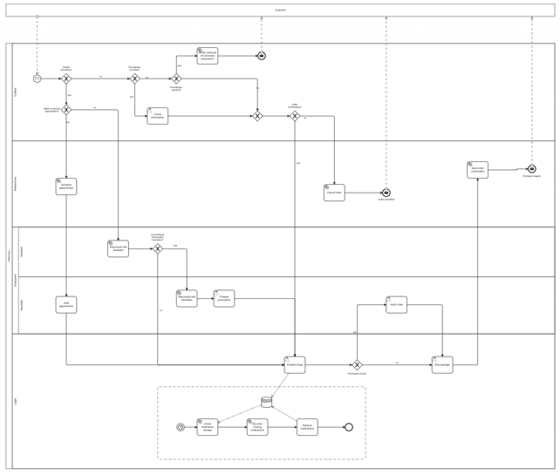
PharmacAI
DEMO
PharmacAI

Slide 12
Scenario Medication with prescription
VIDEO

Slide 13
Scenario Medication without knowing the drug
VIDEO

Slide 14
Scenario Book Appointment - Teleconsultion
VIDEO

Slide 15

THANK YOU

